Slide 1
Azure Brushup

Slide 2








Slide 3


Azure AD
Identity and Access Management
Users
Groups
App Registration
Self Service Password Reset

Slide 4
User 1
User 2
User 3
User 4
User 5
Group 1
Group 2
Group 3
Group 4
Group 5
Subscription 1
RG 1
RG 2
RG3
Subscription 2
RG 4
RG 5
Management Group
Subscription 1
RG 1
RG 2
Subscription 2
RG 4
RG 3
RG 5

Slide 5
Virtual Machines
Compute Resource
Tag
Naming
Security – Inbound and Outbound Rules
Region
Networking
High Availability – Availability Set, Availability Zone, VMSS

Slide 6

Storage Account
Storage Account Type
GPv2
GPv1
Blob Storage
Blobs, Files, Tables, Queues
Storage Security
Encryption
RBAC
Access Keys
Shared Access Signature
Azure AD Authentication

Slide 7

Storage Redundancy
LRS
ZRS
GRS
RA-GRS
GZRS
RA-GZRS

Slide 8
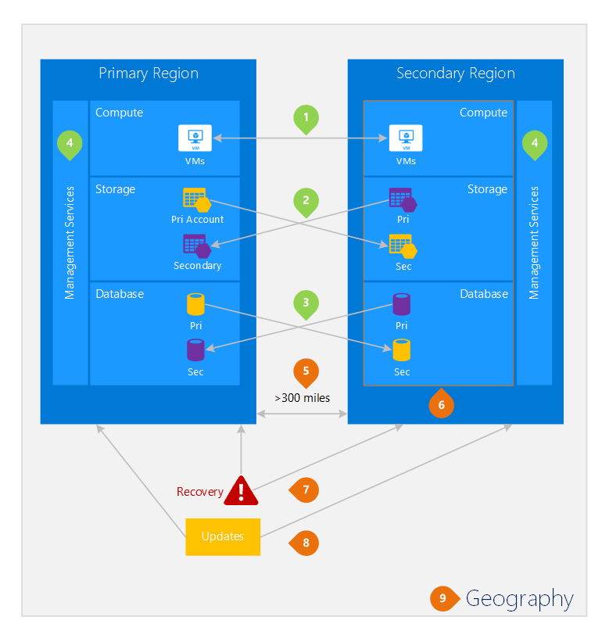

Slide 9
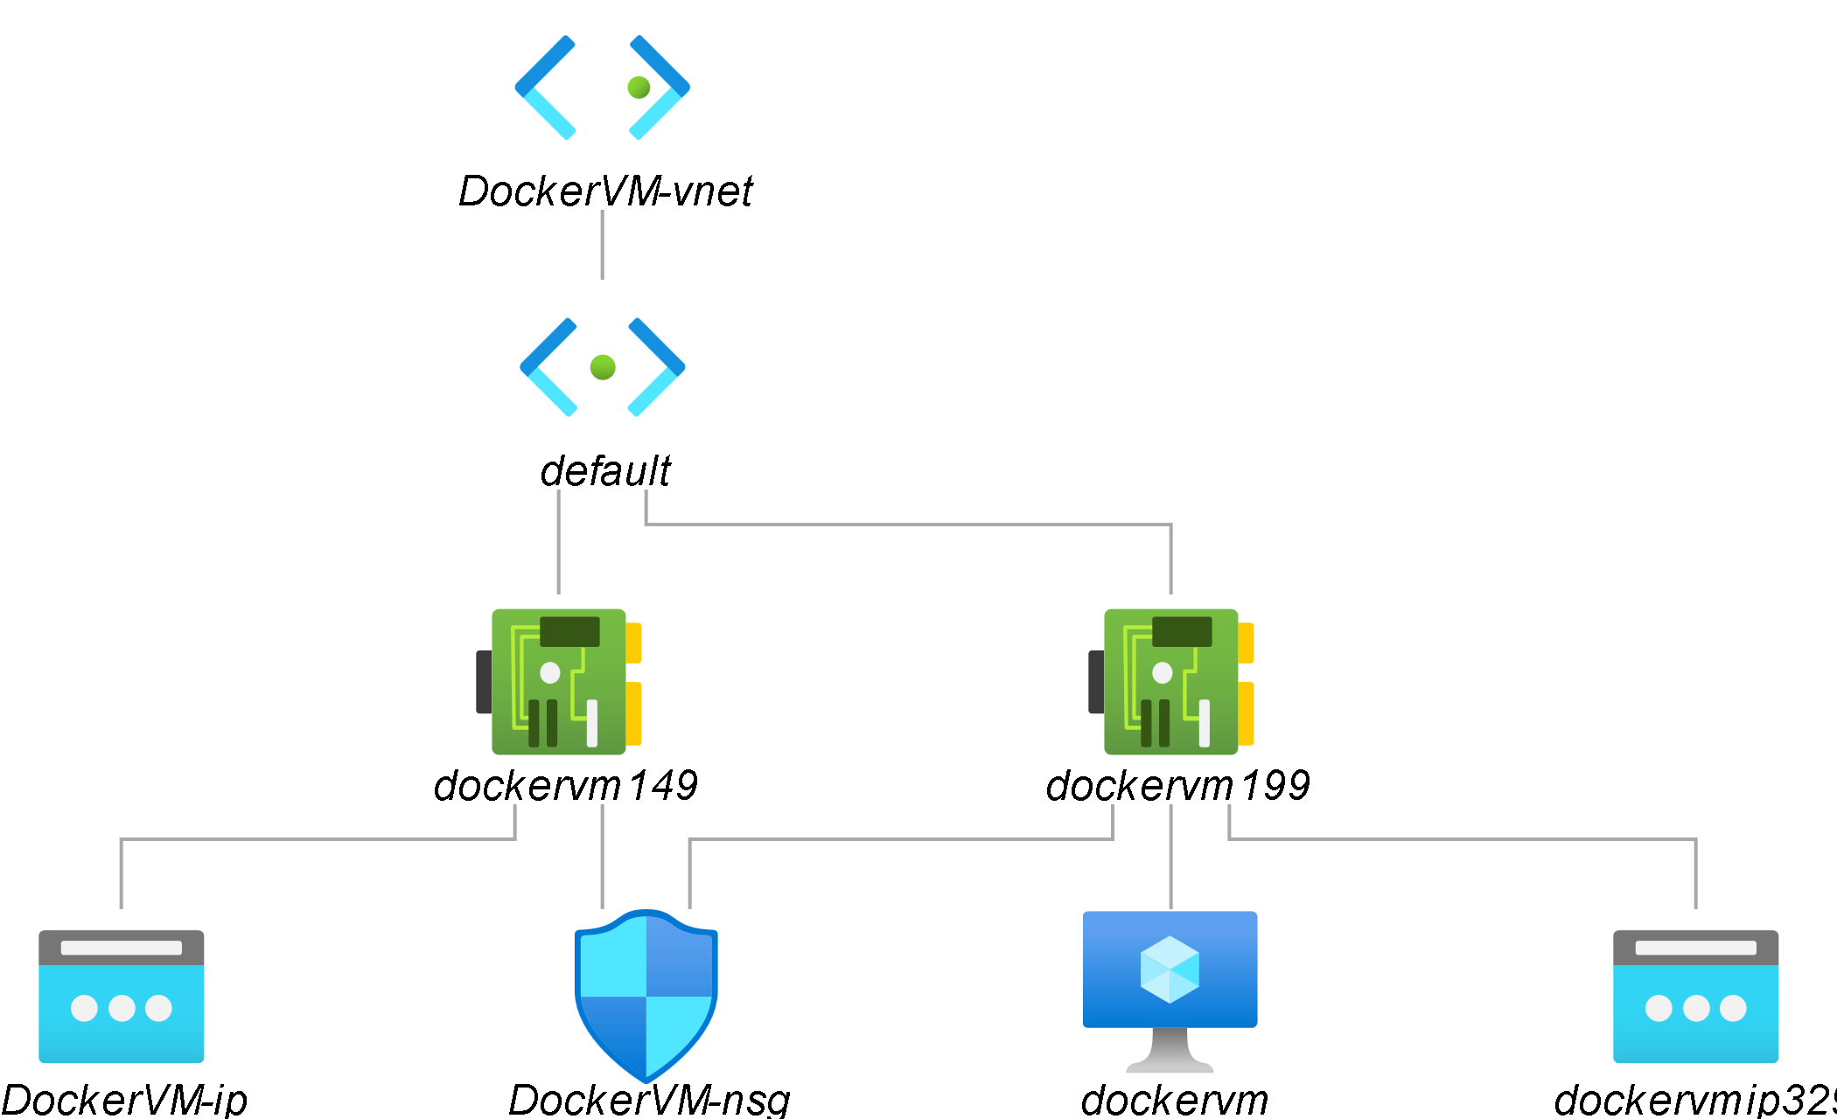
Virtual Networks
Representation of your own network in the cloud.
Subnets
10.0.0.0/16
IP Address
Network Security Group – Inbound and Outbound – NIC and Subnet
NIC

Slide 10
VNet Peering
Interconnection between two Virtual Networks
Regional – VNets part of same region
Global – VNets part of different region

Slide 11
Load Balancer
Layer 4 – TCP and UDP
Fronted IP Configuration –
Backend Pool of VMs
Health Probe
Load Balancing Rule

Slide 12
Platform as a Service
Azure App Services
Container Instance
Kubernetes Service

